Slide 1
Jeff Downes January 25, 2018

Slide 2
“Parks and Recreation”

Slide 3
Have you ever had…
the City Council regular who dominates the dialogue?
The Regular

Slide 4
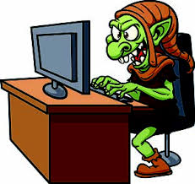
Have you ever had…
the social media troll who shares misinformation?
The Troll

Slide 5
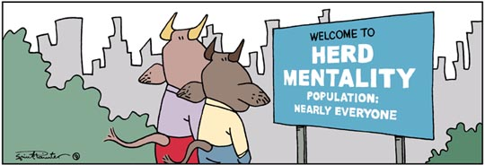
Have you ever had…
elected official fear of community input on an issue?
The Mob

Slide 6
We did in Vestavia Hills.

… So we created

Slide 8
Vestavia Hills Listens is a tool to engage input from the community in a calm, interactive environment.
General feedback/inquiries
Surveys
Virtual participation
Real time feedback

Slide 9
The platform for the Vestavia Hills Listens virtual town hall was developed by Peak Democracy, which joined OpenGov in late 2017. The platform offers a broad variety of configurations for topics.
VH Listens since 2016: 2,566 unique visitors, 1,400 participants (both registered and unregistered), and 628 subscribers to date. 96% satisfaction rating with those surveyed about their use.
Here’s what they say…
"Yes. It is very inconvenient for me to attend city meetings, at times impossible. Also, on issues I have no vested interest in, or if I feel they affect others so much more than myself, I don't really need/want the details. This service allows me to collect information and voice my opinion. I really appreciate it!"
" Very simple to use; I was unable to attend any of the meetings regarding the pool but I still wanted to express an opinion as a citizen of Vestavia who has a vested interest in the facilities at Wald Park."
"I like the opportunity to voice my opinion in a community where we own property."

Slide 11
Vestavia Hills Listens is a tool to engage input from the community in a calm, interactive environment.
General feedback/inquiries
Surveys
Virtual participation
Real time feedback

Slide 13
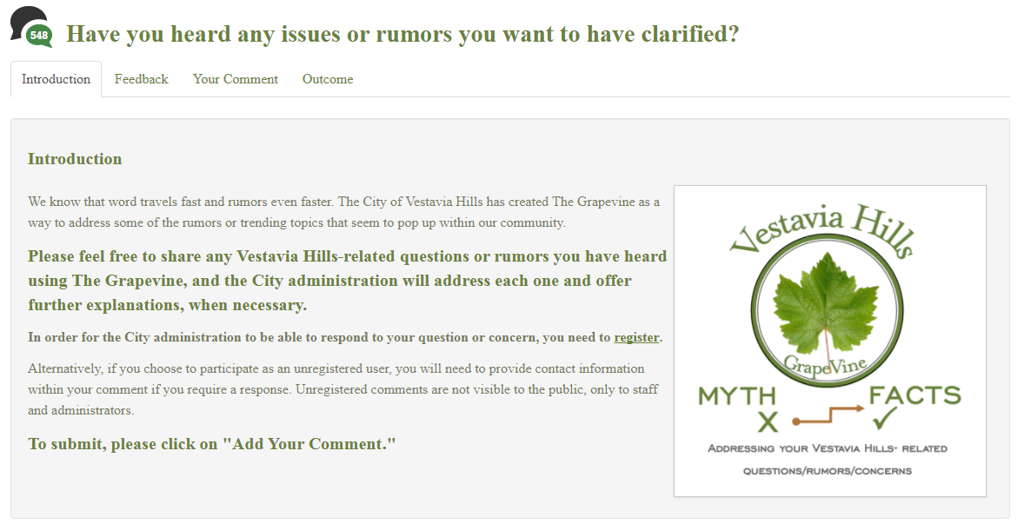
Vestavia Hills Listens is a tool to engage input from the community
The Vestavia Hills GrapeVine is an open topic on the Vestavia Hills Listens Forum.

Slide 15
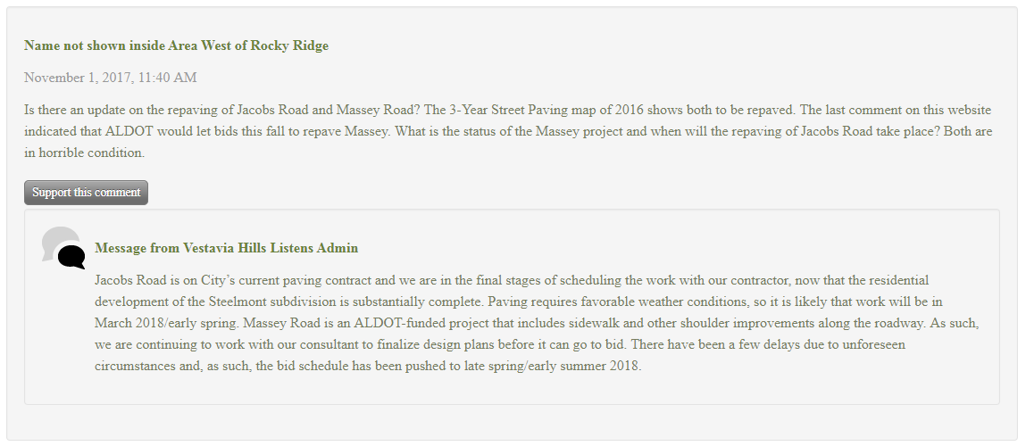
Vestavia Hills Listens is a tool to engage input from the community
Registered users can choose to be anonymous.
Other users can support a comment.
Multiple visits are allowed.
Admins can respond publicly to registered responses.

Slide 16
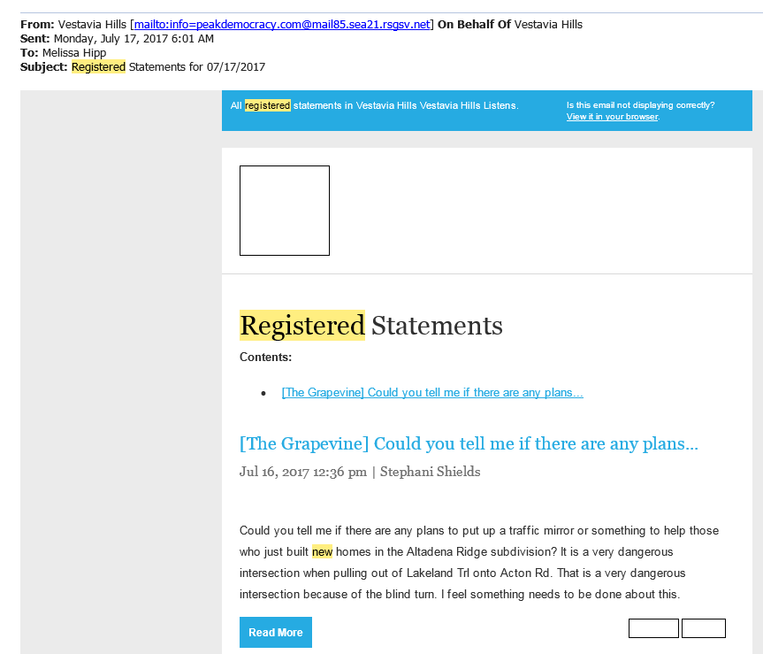
Admins receive email alerts for new registered statements.

Slide 17
Vestavia Hills Listens is a tool to engage input from the community in a calm, interactive environment.
General feedback/inquiries
Surveys
Virtual participation
Real time feedback

Slide 18
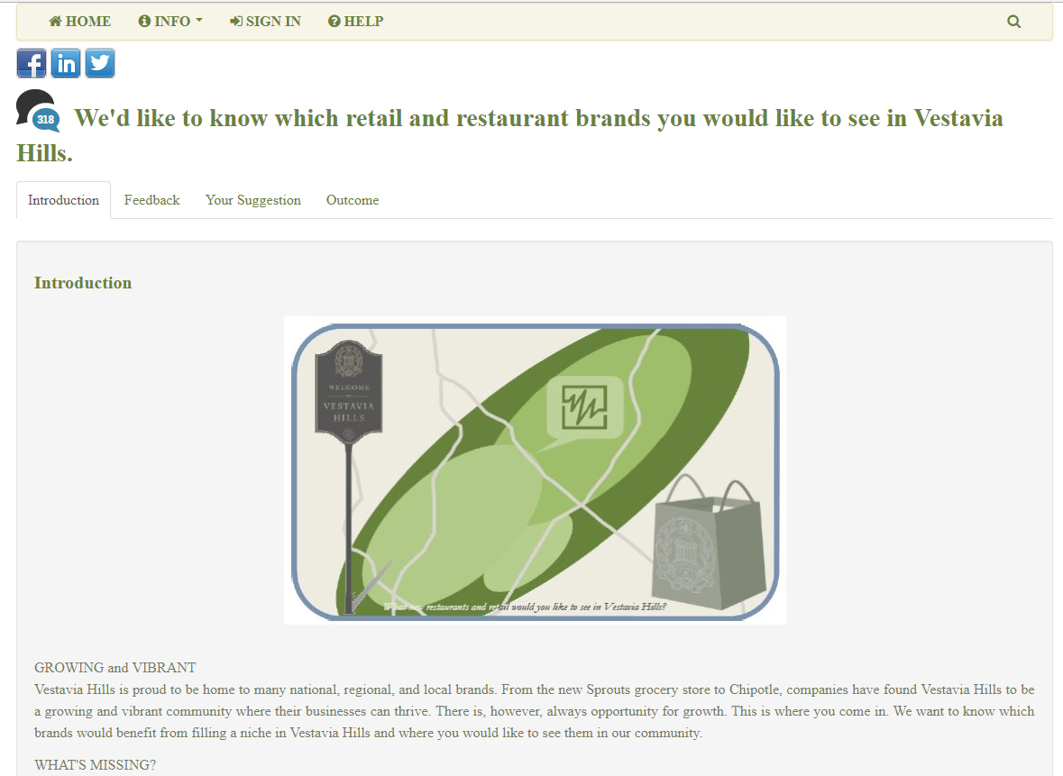

Slide 19
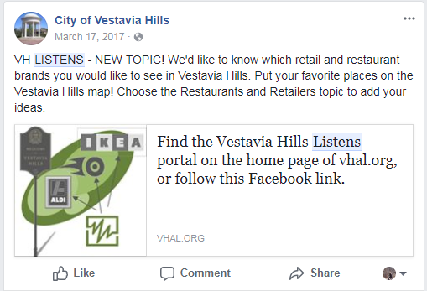
Participation promoted using Facebook.

Slide 20
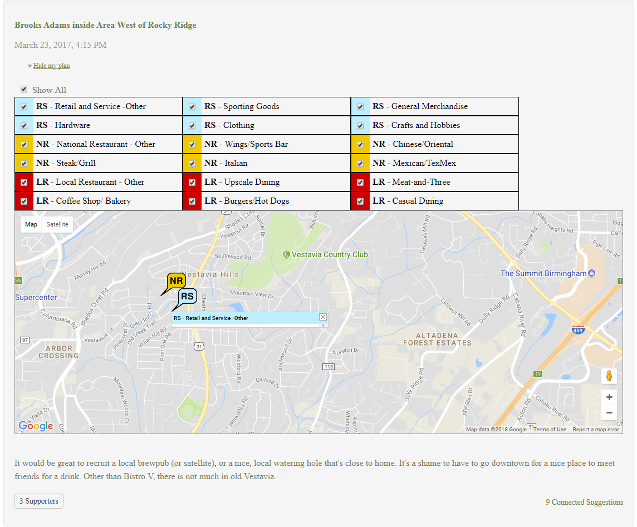
Individual Response with 3 Supporters.

Slide 21
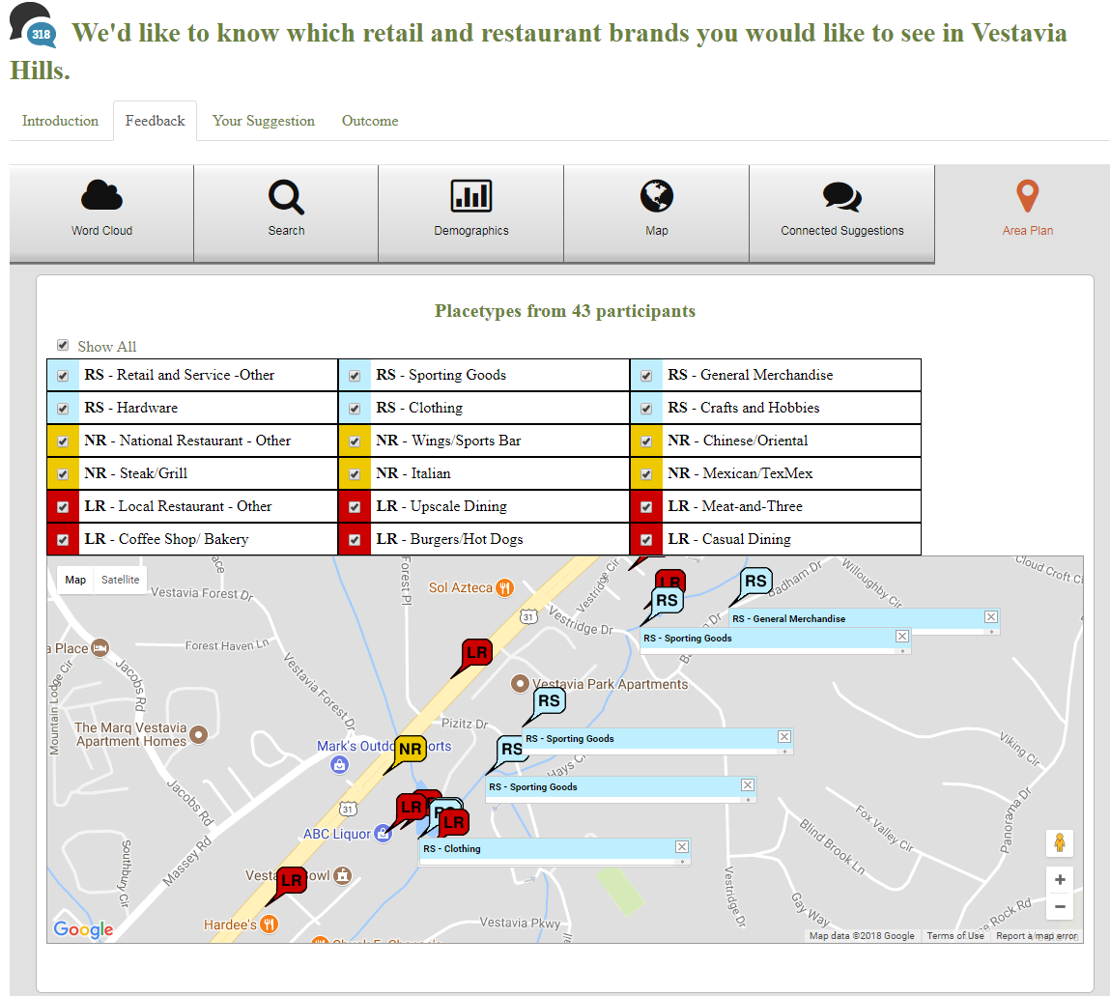

Slide 23
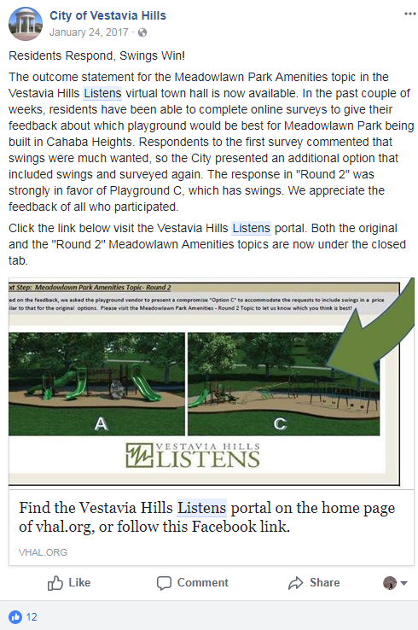
Results communicated using Facebook.

Slide 24
Vestavia Hills Listens is a tool to engage input from the community in a calm, interactive environment.
General feedback/inquiries
Surveys
Virtual participation
Real time feedback

Slide 25
Virtual Participation Example – Community Spaces Plan

Slide 26
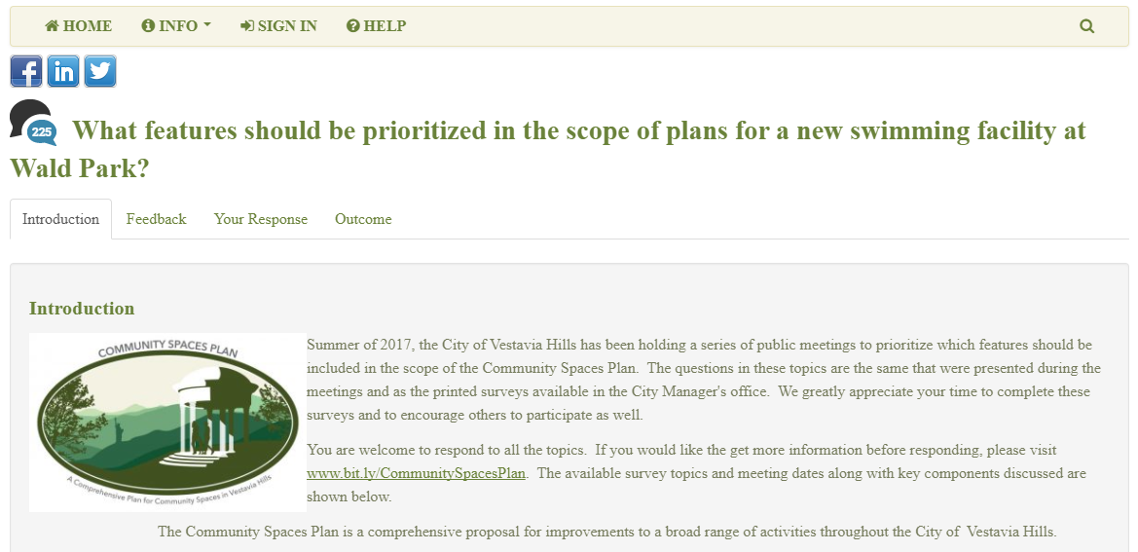
Example – Community Spaces Plan

Slide 27
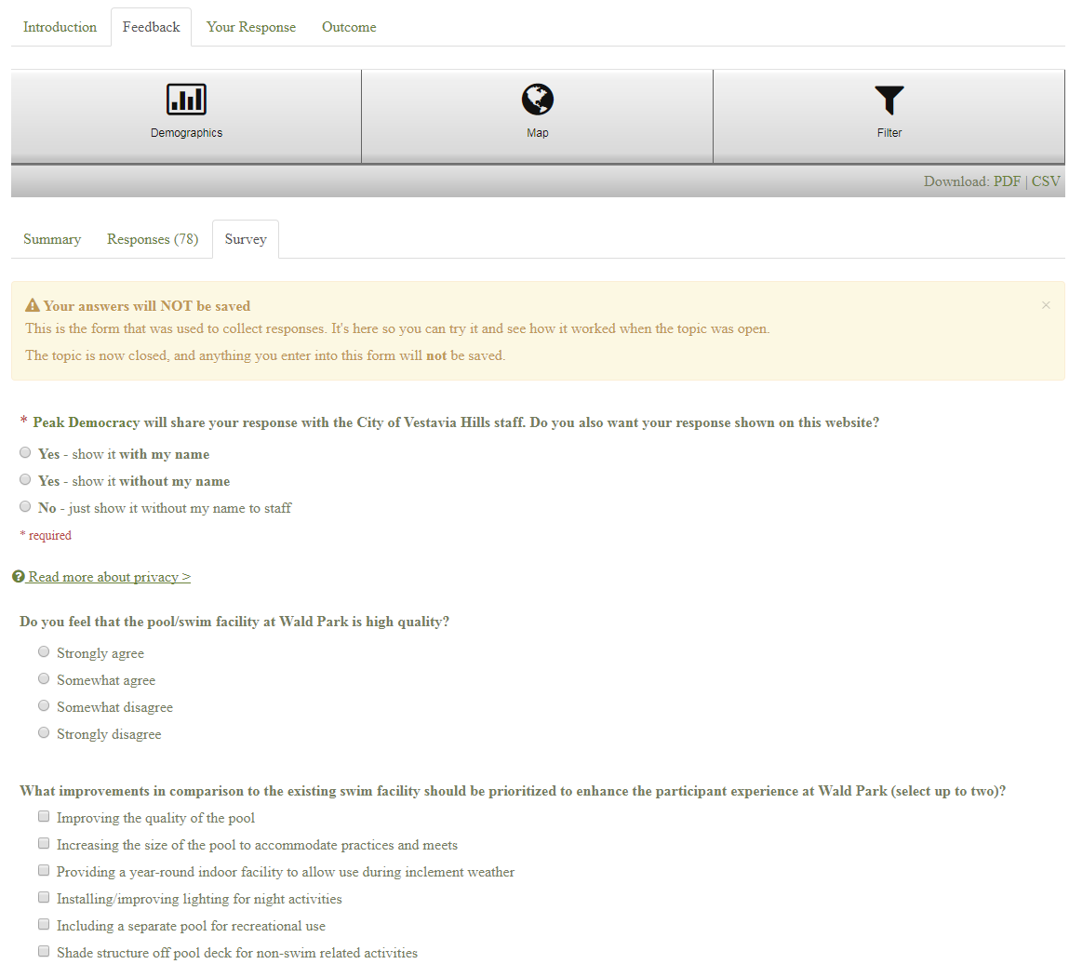
Virtual Participation Example – Community Spaces Plan

Slide 28
Virtual Participation Example – Community Spaces Plan

Slide 29
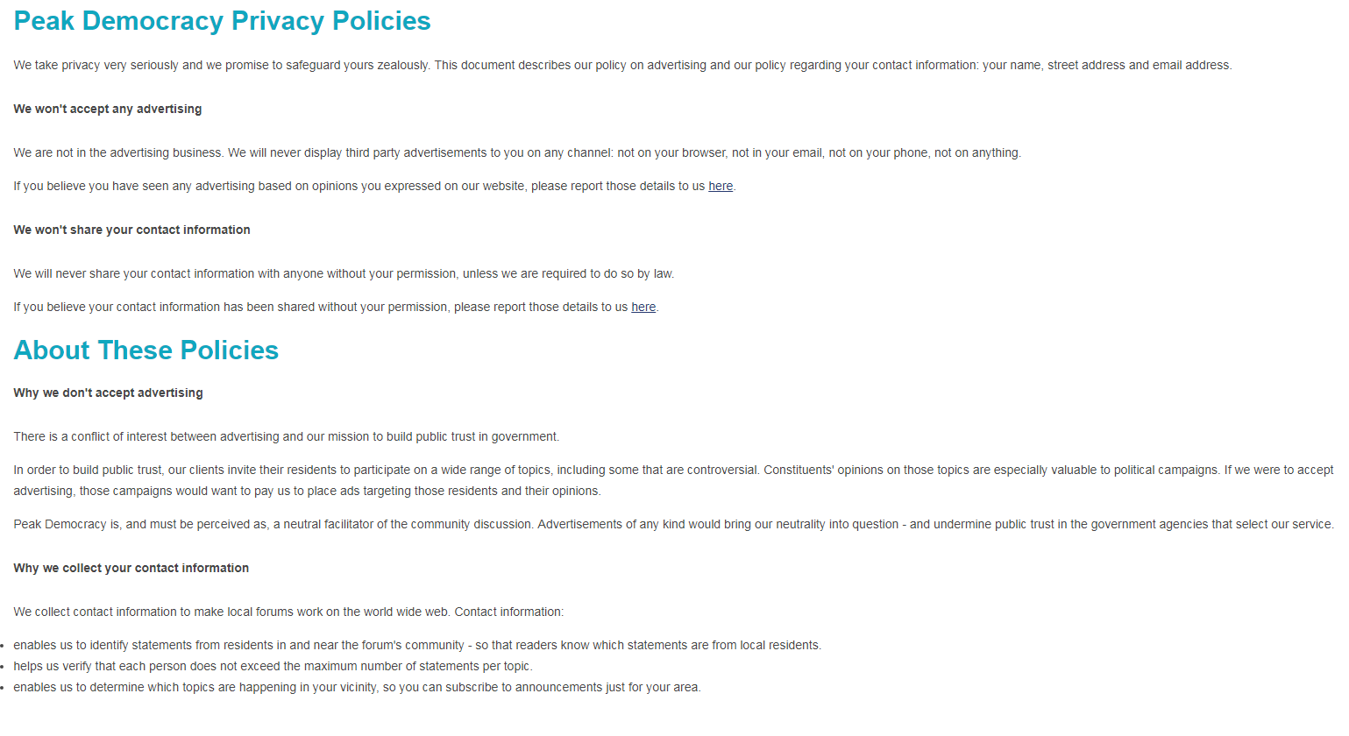
Public Trust, Neutrality, and Privacy

Slide 30
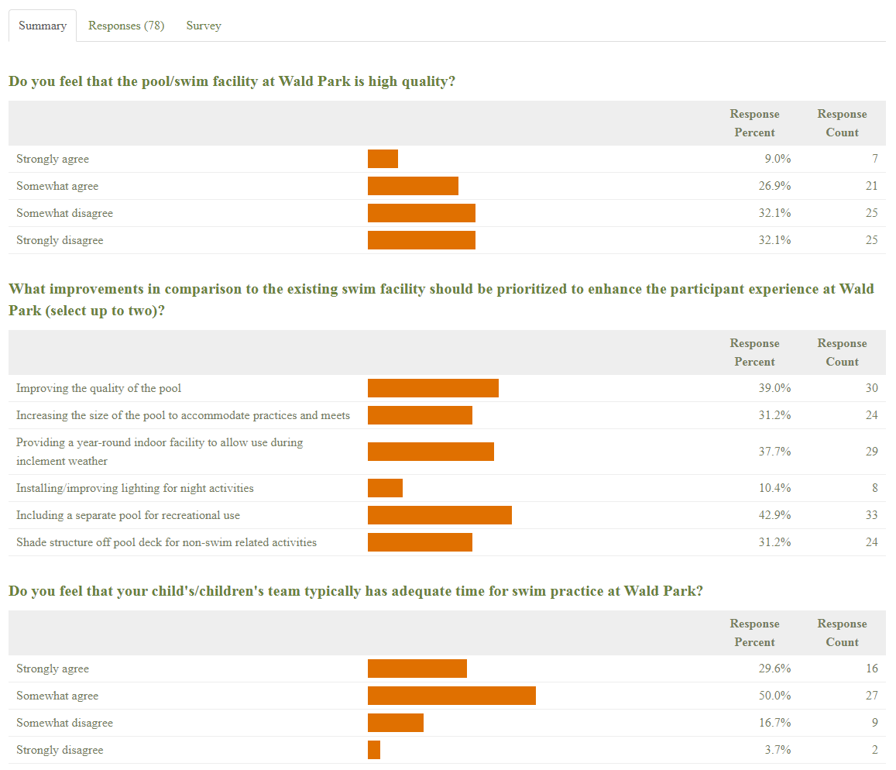
Virtual Participation Example – Community Spaces Plan

Slide 31
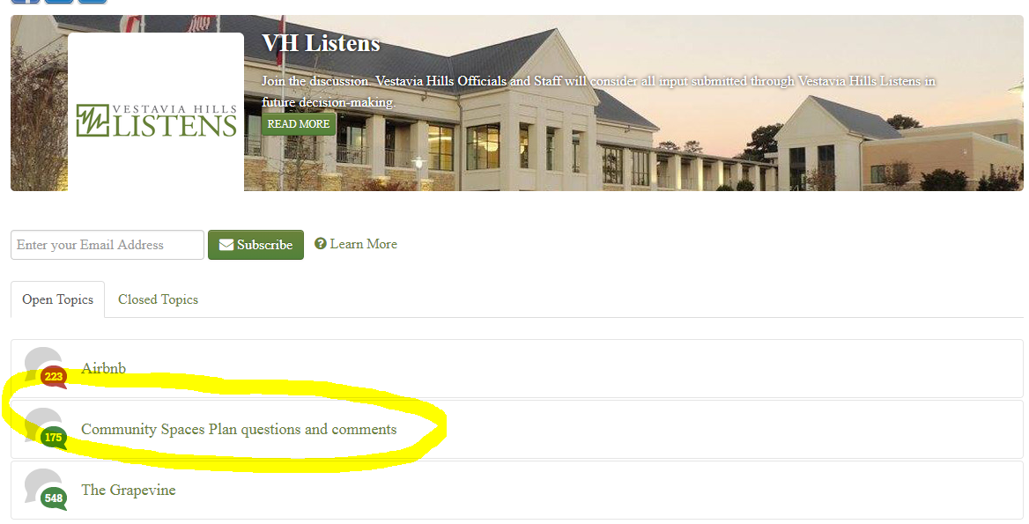
Example – Community Spaces Plan

Slide 32
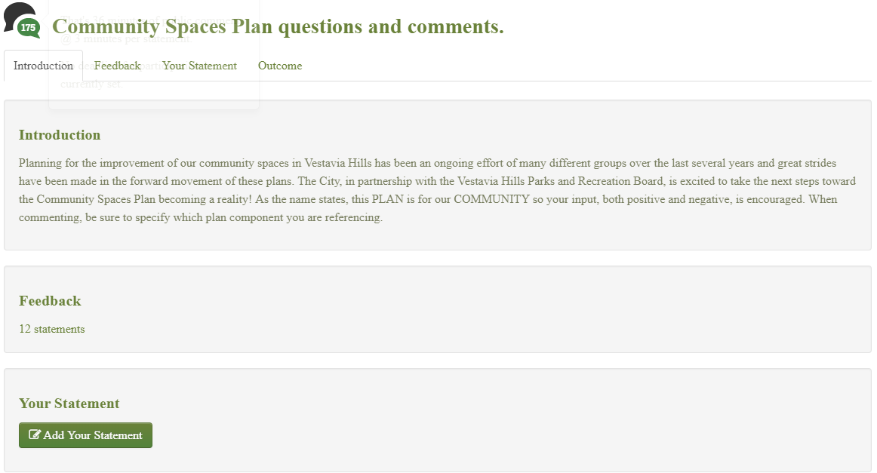
Example – Community Spaces Plan

Slide 33
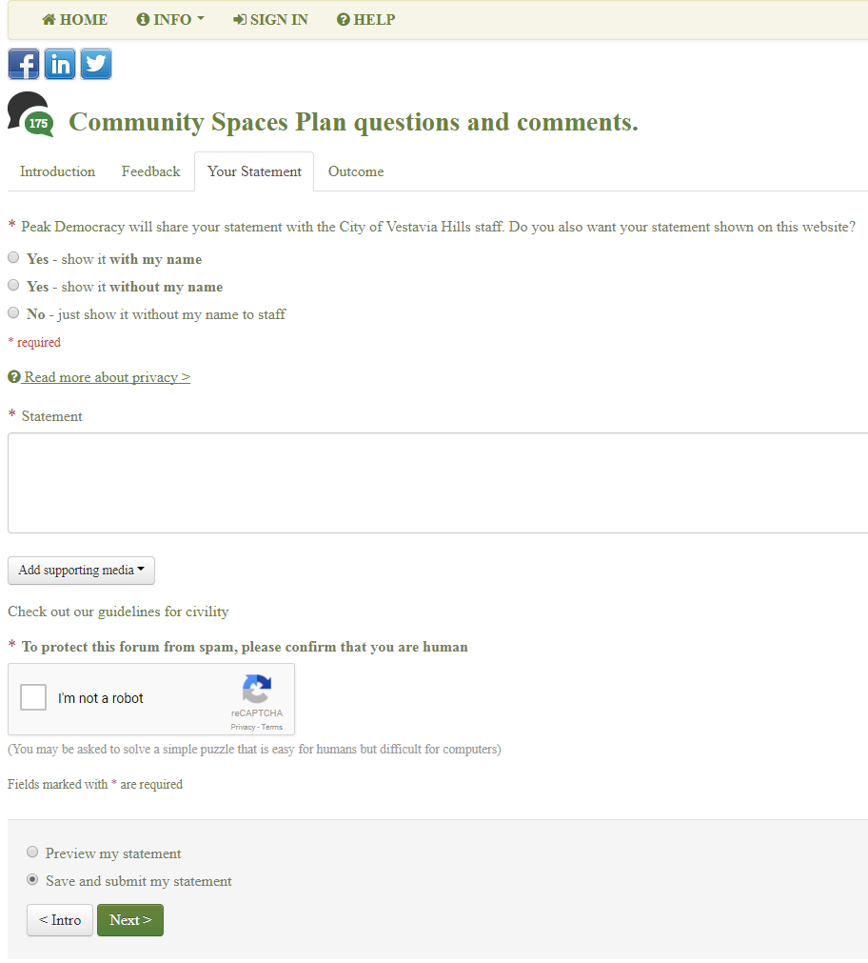
Virtual Participation Example – Community Spaces Plan

Slide 34
Vestavia Hills Listens is a tool to engage input from the community in a calm, interactive environment.
General feedback/inquiries
Surveys
Virtual participation
Real time feedback

Slide 35
Please go to otmeet.com/256

